Slide 1
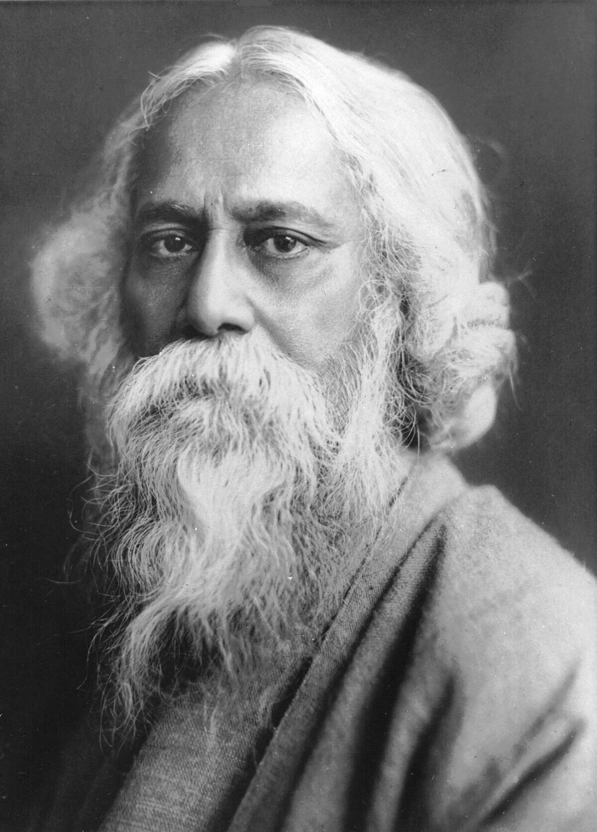
Rabindranath Tagore
Rabindranath Thakur: pronounced bindɾonat anglicised as Rabindranath Tagore 7 May 1861– 7 August 1941) was an Indian polymath who worked as a poet, writer, playwright, composer, philosopher, social reformer, and painter of the Renaissan.
He reshaped Bengali literature and music as well as Indian art with Contextual Modernism in the late 19th and early 20th centuries. Author of the "profoundly sensitive, fresh and beautiful" poetry of in 1913 Tagore became the first non-European and the first lyricist to win the Nobel Prize in Literature.Tagore's poetic songs were viewed as spiritual and mercurial; where his elegant prose and magical poetry were widely popular in the Indian subcontinent.^{[9]} He was a fellow of the Royal Asiatic Society. Referred to as "the Bard of Bengal",Tagore was known by the sobriquets Gurudeb, Kobiguru, and Biswokobi.

Slide 2
A Bengali Brahmin from Calcutta with ancestral gentry roots in Burdwan district^{[12]} and Jessore, Tagore wrote poetry as an eight-year-old.^{[13]} At the age of sixteen, he released his first substantial poems under the pseudonym Bhānusiṃha ("Sun Lion"), which were seized upon by
literary authorities as long-lost classics.^{[14]} By 1877 he graduated to his first short stories and dramas, published under his real name. As a humanist, universalist, internationalist, and ardent critic of nationalism,^{[15]} hedenounced the British Raj and advocated independence from Britain.
As an exponent of the Bengal Renaissance, he advanced a vast canon that comprised paintings, sketches and doodles, hundreds of texts, and some two thousand songs; his legacy also endures in his founding of Visva-Bharati University.

Slide 3
Tagore modernised Bengali art by spurning rigid classical forms and resisting linguistic strictures. His novels, stories, songs, dance dramas, and essays spoke to topics political and personal. Gitanjali (Song Offerings), Gora (Fair-Faced) and Ghare-Baire (The Home and the World) are his best-known works, and his verse, short stories, and novels were acclaimed—or panned—for their lyricism, colloquialism, naturalism, and unnatural contemplation. His compositions were chosen by two
nations as national anthems: India's "Jana Gana Mana" and Bangladesh's "Amar Shonar Bangla" .The Sri Lankan national anthem was also inspired by his work.^{[18]} His song "Banglar Mati Banglar Jol" has been adopted as the state anthem of West Bengal.

Slide 4
Family background
The name Tagore is the anglicised transliteration of Thakur.^{[19]} The original surname of the Tagores was Kushari. They were Pirali Brahmin ('Pirali' historically carried a stigmatized and pejorative connotation)^{[20][21]} who originally belonged to a village named Kush in the district named Burdwan in West Bengal. The biographer of Rabindranath Tagore, Prabhat Kumar Mukhopadhyaya wrote in the first volume of his book Rabindrajibani O Rabindra Sahitya Prabeshak thatThe Kusharis were the descendants of Deen Kushari, the son of Bhatta Narayana; Deen was granted a village named Kush (in Burdwan zilla) by Maharaja Kshitisura, he became its chief and came to be known as Kushari.

Slide 5
Life and events:-Early life: 1861–1878
The youngest of 13 surviving children, Tagore (nicknamed "Rabi") was born on 7 May 1861 in the Jorasanko mansion in Calcutta,^{[23]} the son of Debendranath Tagore (1817–1905) and Sarada Devi (1830–1875).
Tagore was raised mostly by servants; his mother had died in his early childhood and his father travelled widely.^{[29]} The Tagore family was at the forefront of the Bengal renaissance. They hosted the publication of literary magazines; theatre and recitals of Bengali and Western classical music featured there regularly. Tagore's father invited several professional Dhrupad musicians to stay in the house and teach Indian classical music to the children.^{[30]} Tagore's oldest
brother Dwijendranath was a philosopher and poet. Another brother, Satyendranath, was the first Indian appointed to the elite and formerly all-European Indian Civil Service. Yet another brother, Jyotirindranath, was a musician, composer, and playwright.^{[31]} His sister Swarnakumari became a novelist.^{[32]} Jyotirindranath's wife Kadambari Devi, slightly older than Tagore, was a dear friend and powerful influence.
left him profoundly distraught for years.

Slide 6
Tagore largely avoided classroom schooling and preferred to roam the manor or nearby Bolpur and Panihati, which the family visited.^{[34][35]} His brother Hemendranath tutored and physically conditioned him—by having him swim the Ganges or trek through hills, by gymnastics, and by practising judo and wrestling. He learned drawing, anatomy, geography and history, literature, mathematics, Sanskrit, and English—his least favourite subject.^{[36]} Tagore loathed formal education—his scholarly travails at the local Presidency
College spanned a single day. Years later he held that proper teaching does not explain things; proper teaching stokes curiosity. After his upanayan (coming-of-age rite) at age eleven, Tagore and his father left Calcutta in February 1873 to tour India for several months, visiting his father's Santiniketan estate and Amritsar before reaching the Himalayan hill station of Dalhousie. There Tagore read biographies, studied history, astronomy, modern science, and Sanskrit, and examined the classical poetry of Kālidāsa.^{[38][39]} During his 1-month stay at Amritsar in 1873 he was greatly influenced by melodious gurbani andNanak bani being sung at Golden Temple for which both father and son were regular visitors. He writes in his My Reminiscences (1912):

Slide 7
The golden temple of Amritsar comes back to me like a dream. Many a morning have I accompanied my father to this Gurudarbar of the Sikhs in the middle of the lake. There the sacred chanting resounds continually. My father, seated amidst the throng of worshippers, would sometimes add his voice to the hymn of praise, and finding a stranger joining in their devotions they would wax enthusiastically cordial, and we would return loaded with the sanctified offerings of sugar crystals and other sweets.
He wrote 6 poems relating to Sikhism and several articles in Bengali children's magazine about Sikhism.

Slide 8
Poems on Guru Gobind Singh:নিষ্ফল উপহার Nishfal-upahaar (1888, translated as "Futile Gift"), গুরু গোবিন্দ Guru Gobinda (1899) and শেষ শিক্ষা Shesh Shiksha (1899, translated as "Last Teachings")
Poem on Banda Bahadur: বন্দী বীর Bandi-bir (The Prisoner Warrior written in 1888 or 1898)^{[41]}
Poem on Bhai Torusingh: প্রার্থনাতীত দান (prarthonatit dan – Unsolicited gift) written in 1888 or 1898^{[41]}
Poem on Nehal Singh: নীহাল সিংহ (Nihal Singh) written in 1935.

Slide 9
Tagore returned to Jorosanko and completed a set of major works by 1877, one of them a long poem in the Maithili style of Vidyapati. As a joke, he claimed that these were the lost works of newly discovered 17th-century Vaiṣṇava poet Bhānusiṃha.^{[42]} Regional experts accepted them as the lost works of the fictitious poet.^{[43]} He debuted in the short-story genre in Bengali with "Bhikharini" ("The Beggar Woman").^{[44][45]} Published in the same year, Sandhya Sangit (1882) includes the poem "Nirjharer Swapnabhanga" ("The Rousing of the Waterfall").

Slide 10
Impact and legacy
Every year, many events pay tribute to Tagore: Kabipranam, his birth anniversary, is celebrated by groups scattered across the globe; the annual Tagore Festival held in Urbana, Illinois (US); Rabindra Path Parikrama walking pilgrimages from Kolkata to Santiniketan; and recitals of his poetry, which are held on important anniversaries.^{[84][167][168]} Bengali culture is fraught with this legacy: from language and arts to history and politics. Amartya Sen deemed Tagore a "towering figure", a "deeply relevant and many-sided contemporary thinker".^{[168][146]} Tagore's Bengali originals—the 1939 Rabīndra Rachanāvalī—is canonized as one of his nation's greatest cultural treasures, and he was roped into a reasonably humble role: "the greatest poet India has produced".^{[169}
Tagore was renowned throughout much of Europe, North America, and East Asia. He co-founded Dartington Hall School, a progressive coeducational institution;^{[170]} in Japan, he influenced such figures as Nobel laureate Yasunari Kawabata.^{[171]} In colonial Vietnam Tagore was a guide for the restless spirit of the radical writer and publicist Nguyen An Ninh^{[172]} Tagore's works were widely translated into English, Dutch, German, Spanish, and other European languages by Czech Indologist Vincenc Lesný,^{[173]} French Nobel laureate André Gide, Russian poet Anna Akhmatova,^{[174]} former Turkish Prime Minister Bülent Ecevit,^{[175]} and others. In the United States, Tagore's lecturing circuits, particularly those of 1916–1917, were widely attended and wildly acclaimed. Some controversies^{[e]} involving Tagore, possibly fictive, trashed his popularity and sales in Japan and North America after the late 1920s, concluding with his "near total eclipse" outside Bengal.^{[9]} Yet a latent reverence of Tagore was discovered by an astonished Salman Rushdie during a trip to Nicaragua.

Slide 11
In popular culture
Rabindranath Tagore is a 1961 Indian documentary film written and directed by Satyajit Ray, released during the birth centenary of Tagore. It was produced by the Government of India's Films Division.
Serbian composer Darinka Simic-Mitrovic used Tagore's text for her song cycle Gradinar in 1962.^{[191]}
In 1969, American composer E. Anne Schwerdtfeger was commissioned to compose Two Pieces, a work for women's chorus based on text by Tagore.^{[192]}
In Sukanta Roy's Bengali film Chhelebela (2002) Jisshu Sengupta portrayed Tagore.^{[193]}
In Bandana Mukhopadhyay's Bengali film Chirosakha He (2007) Sayandip Bhattacharya played Tagore.^{[194]}
In Rituparno Ghosh's Bengali documentary film Jeevan Smriti (2011) Samadarshi Dutta played Tagore.^{[195]}
In Suman Ghosh's Bengali film Kadambari (2015) Parambrata Chatterjee portrayed Tagore.

Slide 12
Theft of Nobel Prize
On 25 March 2004, Tagore's Nobel Prize was stolen from the safety vault of the Visva-Bharati University, along with several other of his belongings.^{[163]} On 7 December 2004, the Swedish Academy decided to present two replicas of Tagore's Nobel Prize, one made of gold and the other made of bronze, to the Visva-Bharati University.^{[164]} It inspired the fictional film Nobel Chor. In 2016, a baul singer named Pradip Bauri, accused of sheltering the thieves, was arrested.^{[165][166]}

Slide 13
Which Nobel Prize received by Rabindranath Tagore:-
Internationally, Gitanjali (Bengali: গীতাঞ্জলি) is Tagore's best-known collection of poetry, for which he was awarded the Nobel Prize in Literature in 1913. Tagore was the first non-European to receive a Nobel Prize in Literature and the second non-European to receive a Nobel Prize after Theodore Roosevelt.

